Slide 1


BLOOD BANK MANAGEMENT SYSTEM

Slide 2

ABSTRACT
Blood banks are organizations that collect, store, and distribute blood and blood products. They play a vital role in the healthcare system by providing blood to patients who need it for surgery, trauma, and other medical conditions. Blood banks are also responsible for ensuring that blood is safe and that it meets the highest standards of quality.
Blood banks are an essential part of the healthcare system. They provide blood to patients who need it and they ensure that blood is safe and meets the highest standards of quality. Voluntary blood donors are the lifeblood of blood banks. They make it possible for blood banks to provide blood to patients who need it.

Slide 3


INTRODUCTION
A blood bank is a center where blood gathered as a result of blood donation is stored and preserved for later use in blood transfusion. The term "blood bank" typically refers to a department of a hospital usually within a Clinical pathology laboratory where the storage of blood product occurs and where pre-transfusion and Blood compatibility testing is performed. However, it sometimes refers to a collection center, and some hospitals also perform collection. Blood banking includes tasks related to blood collection, processing, testing, separation, and storage
Blood donation is a simple, safe, and rewarding way to help save lives. Every two seconds, someone in the world needs blood. That's why it's so important to have a reliable supply of blood available.
This Photo by Unknown author is licensed under CC BY-NC-ND.

Slide 4

MODULE
Home:
Welcome to the Blood Bank Site, a reliable and comprehensive platform dedicated to the efficient management of blood donations and ensuring a steady supply of blood for those in need.our site is designed to streamline the process of blood donation, storage, and distribution. Whether you are a potential donor, a healthcare facility in search of blood products, or an individual seeking lifesaving transfusions, our site offers a user-friendly interface, advanced features, and a commitment to maintaining the highest standards of quality and safety.

Slide 5


MODULE
Register/Login:
Users can register as a member, the user can become a member after login, modify personal information, modify the password and exit. For buying any books we have to sign up with an account so tha we can login any time buying any books and visiting any book page and to give the review
Sign In:
The users can sign in into lbrcequiz.in just by entering the simple details like Name, Mail Id and should set up an strong password to protect from hacking attacks of users account.

Slide 6
TECHNOLOGIES
HTML :
HTML stands for Hypertext Markup Language. It is the most widely used language to create web pages. HTML is a markup language used to simply ―mark-up a text document with tags that tell a web browser how to structure it to display.
CSS :
The cascading style sheet (CSS) is a markup language used in web document for presentation purpose. The purpose of CSS is to separate web content from web presentation.
JDBC :
JDBC stands for Java Database Connectivity. JDBC is a Java API to connect and execute the query with the database. It is a part of JavaSE (Java Standard Edition). JDBC API uses JDBC drivers to connect with the database.
JSP :
JSP technology is used to create web application just like Servlet technology. It can be thought of as an extension to Servlet because it provides more functionality than servlet such as expression language, JSTL, etc.

Slide 7
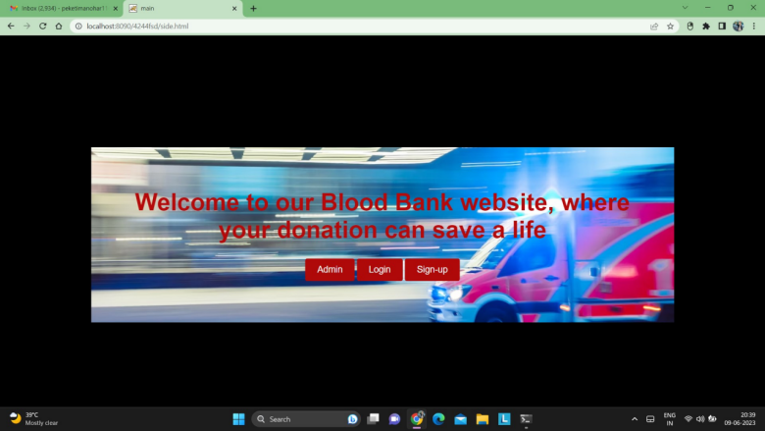
SCREEN SHOTS (Main page)

Slide 8
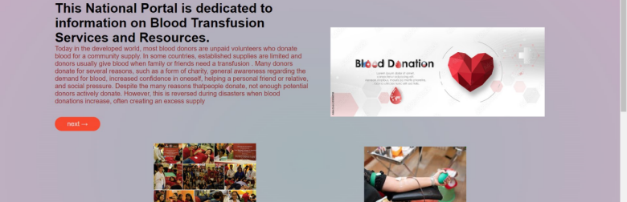
SCREEN SHOTS (Home page)

Slide 9
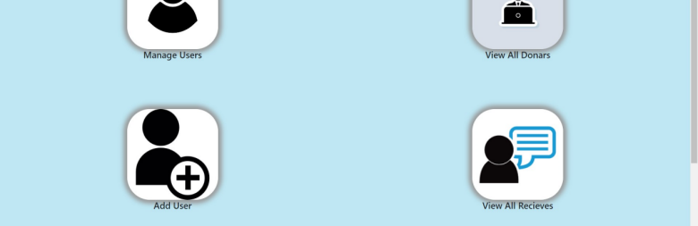
SCREEN SHOTS (Admin page)

Slide 10
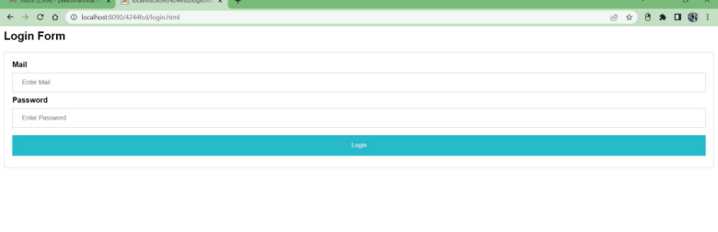
SCREEN SHOTS ( Login page)

Slide 11
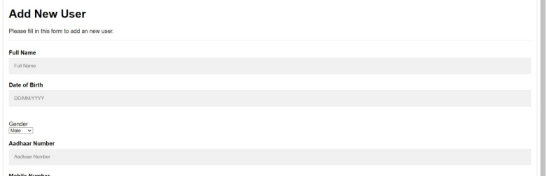
SCREEN SHOTS ( Sign-in page)

Slide 12

CONCLUSION
I have had the privilege of creating and maintaining the Blood Bank website, a vital platform that connects donors, healthcare facilities, and individuals in need of blood. Through the implementation of advanced technologies and a user-friendly interface, we have ensured that the process of blood donation and management is efficient, reliable, and accessible to all
BY-SA.

